Slide 1




Boyertown Area
School District
Data Summary
2014-15
Notes:
Each year I put together an updated data summary booklet that serves as a reference for Board Members and administrators throughout the year. Available online.

Slide 2
Agenda
Data Analysis
Priority Areas
Demographic Data
School Performance Profile
State Assessment Data
Advanced Placement/Concurrent Enrollment
Extra Curricular Activities

Slide 3
Examining Data
There are a number of questions that we should explore when we examine data:
What are the trends?
What are possible causal factors (focus on factors that we control)?
What are possible remedies?
What don’t we know?
What are our priorities?

Slide 4
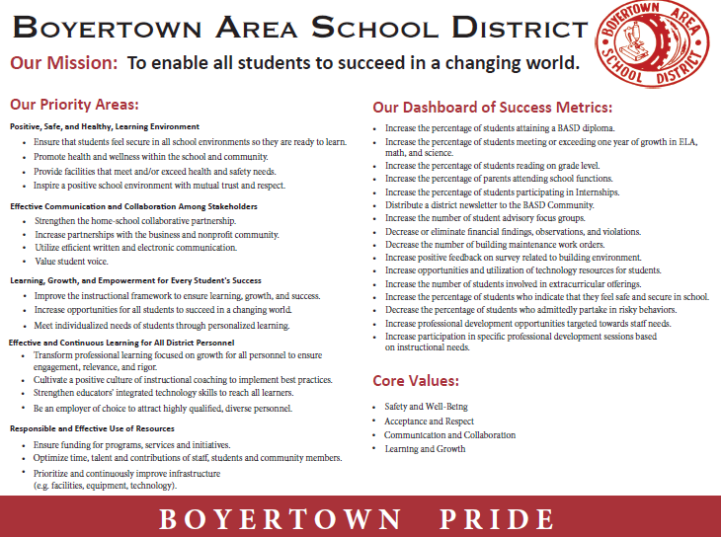

Slide 5
Student Enrollment Data
Grade | Sept. 2008 | Sept. 2009 | Sept. 2010 | Sept. 2011 | Sept. 2012 | Sept. 2013 | Sept. 2014 | Sept. 2015
K | 511 | 496 | 491 | 509 | 480 | 482 | 492 | 418
1 | 473 | 554 | 522 | 520 | 573 | 526 | 521 | 522
2 | 525 | 457 | 562 | 538 | 519 | 568 | 510 | 526
3 | 533 | 529 | 477 | 571 | 544 | 534 | 582 | 514
4 | 583 | 533 | 539 | 496 | 578 | 546 | 538 | 576
5 | 513 | 589 | 545 | 549 | 491 | 589 | 529 | 548
6 | 523 | 514 | 583 | 572 | 551 | 504 | 589 | 533
7 | 571 | 532 | 522 | 600 | 585 | 559 | 520 | 580
8 | 559 | 568 | 544 | 523 | 594 | 593 | 559 | 519
9 | 590 | 565 | 586 | 534 | 533 | 586 | 575 | 553
10 | 563 | 585 | 576 | 591 | 531 | 546 | 582 | 589
11 | 530 | 541 | 578 | 569 | 575 | 512 | 523 | 563
12 | 542 | 510 | 537 | 577 | 555 | 572 | 501 | 502
TOTAL | 7016 | 6973 | 7087 | 7149 | 7109 | 7117 | 7021 | 6952
Notes:
12th day enrollment

Slide 6
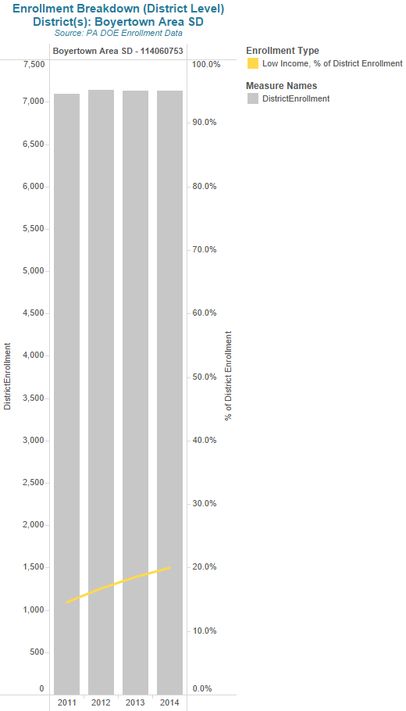
Notes:
October 1st

Slide 7
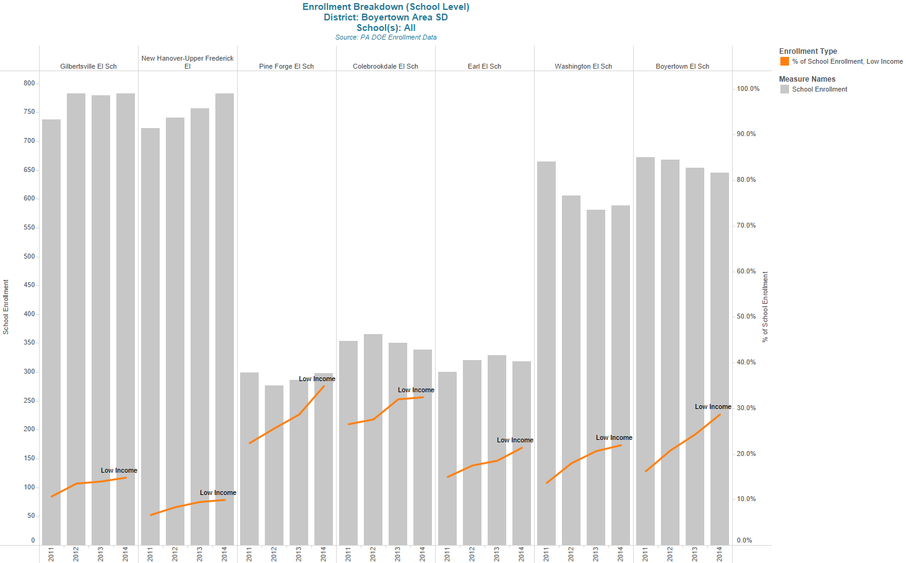
Notes:
October 1st

Slide 8
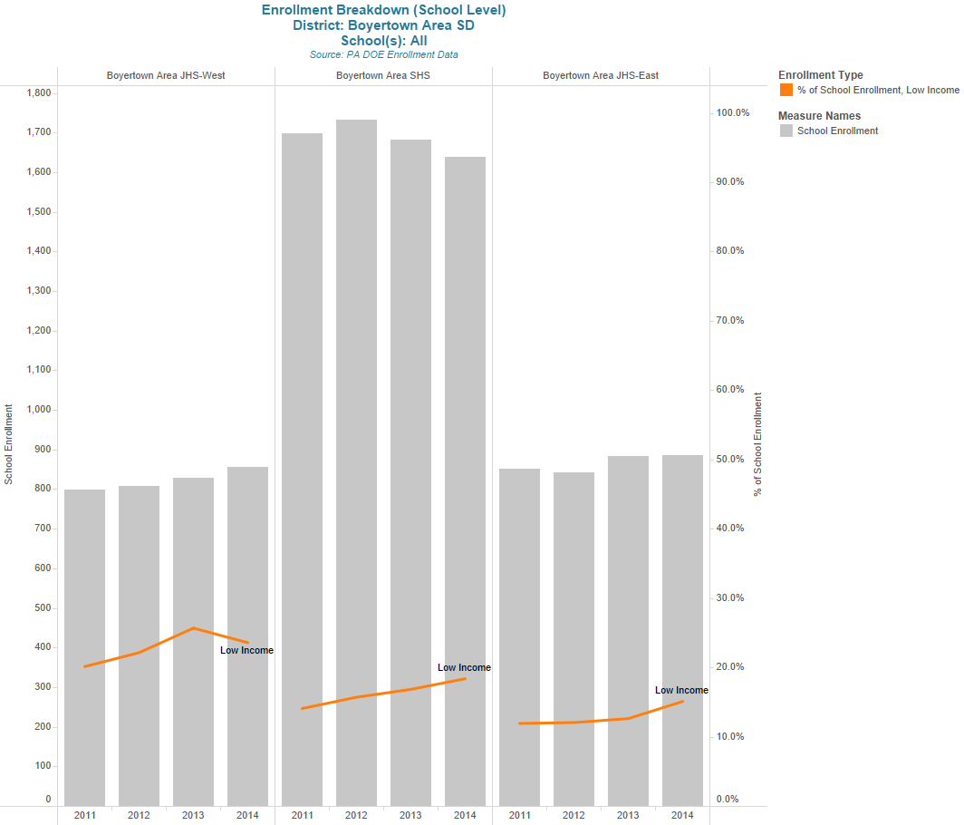
Notes:
October 1st

Slide 9
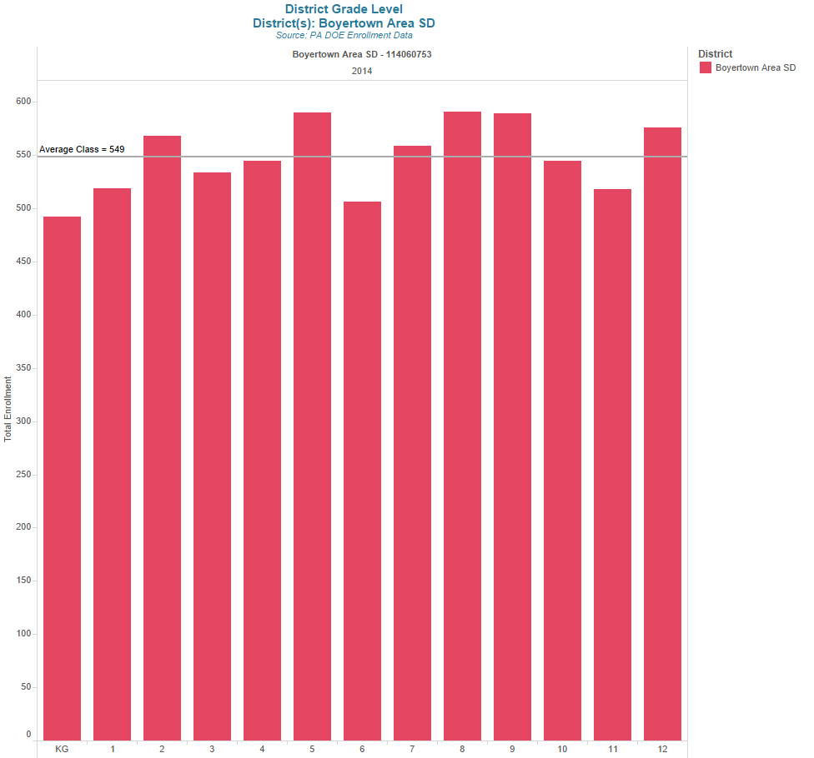
Notes:
October 1st

Slide 10
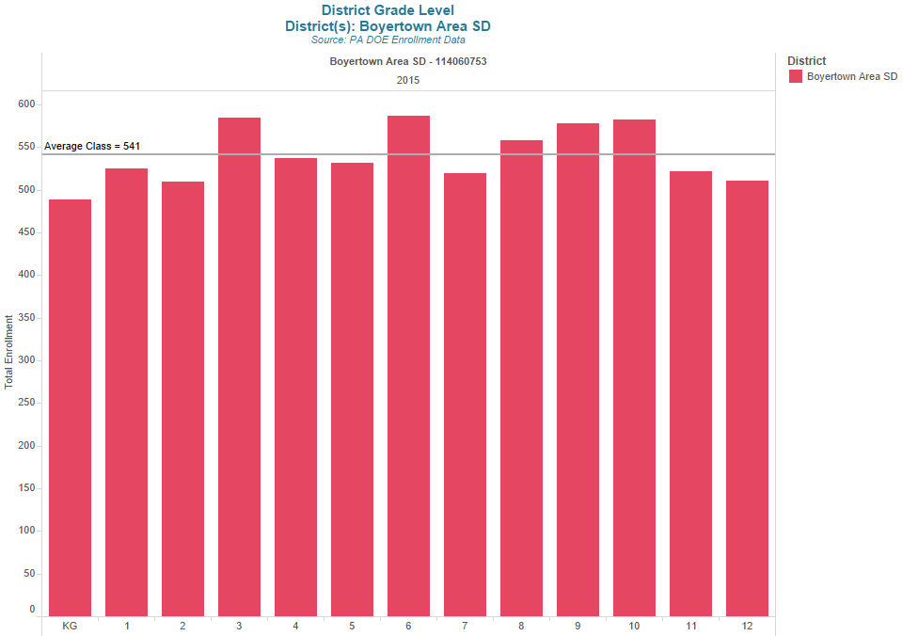
Notes:
October 1st

Slide 11

The PA School Performance Profile is designed to:
Provide a building level academic score for teachers as part of the Educator Effectiveness System
Inform the public of the performance of each public school, comprehensive career and technical center, cyber charter and charter school in Pennsylvania
Provide parents and taxpayers with performance measures for the school/district of residence, neighboring schools/districts and schools/districts across the state
11
Notes:
Refer to Overview handout - Introduction.
The PA School Performance Profile serves several purposes:
Provide a building level score for teachers, as part of the Educator Effectiveness System beginning 2013-2014.
Inform the public of the academic performance measures of each school, comprehensive career and technical center, cyber charter and charter school in
Pennsylvania
Provide parents with performance measures for the school/district of residence, neighboring schools/districts and schools/districts across the state

Slide 12
For school districts, the School Performance Profile serves multiple purposes:
Inform and guide goal setting, resource allocation, and targets for improved student achievement
Communicate performance to various constituencies
Compare performance to other schools
Encourage implementation of best practices
Purpose
Notes:
An important goal of the School Performance Profile is to assist schools and districts to inform and guide strategic decision making to improve student achievement.

Slide 13
For school districts, the School Performance Profile serves multiple purposes:
Inform and guide goal setting, resource allocation, and targets for improved student achievement
Communicate performance to various constituencies
Compare performance to other schools
Encourage implementation of best practices
Purpose
High School Only due to the implementation of the new PSSA at earlier grades.
Notes:
An important goal of the School Performance Profile is to assist schools and districts to inform and guide strategic decision making to improve student achievement.

Slide 14
School Performance Profile Scores
School | SPP
Boyertown Area Senior High | 84.3
3rd out of 18 in Berks County
17th out of 22 in Montgomery County
Notes:
13-14 2/18 in Berks 12/22 in Montgomery County
12-13 2/18 in Berks 15/22 in Montgomery County
Not included in the 22 is an Alternative school, 9th grade center, Jenkinstown (no score at last I checked)

Slide 15
School Performance Profile Scores
The score is based upon multiple measures which define high performing schools.
Many data elements are combined to create the academic score. These elements are categorized into five areas.
Notes:
Refer to Understanding Academic Performance Score Handout.
The Educator Effectiveness System (Act 82 of 2012) is designed to evaluate teachers based upon classroom observations, teacher specific data, elective data, and building level data. The building level data is the school academic performance score derived from the Pennsylvania School Performance Profile. It comprises 15% of each teacher and principal’s evaluation and will be a part of the Educator Effectiveness system starting with the 2013-2014 and 2014-2015 school year, respectively.

Slide 16
Pennsylvania School Performance Profile
The PA School Performance Profile provides a quantitative academic score based upon a 100-point scale using the following source data:
Indicators of Academic Achievement (40%)
Indicators of Closing the Achievement Gap (10%)
Indicators of Academic Growth / PVAAS (40%)
Other Academic Indicators (10%)
Extra Credit for Advanced Achievement (up to 7 points)

Slide 17
Indicators of Academic Achievement (40%)
Percent Proficient or Advanced on Pennsylvania State Assessments (PSSA or Keystone) Mathematics, ELA, and Science
Percent Competent or Advanced on industry certification exams (NOCTI: a job ready assessment for career and technical center students)
Percent Proficient or Advanced on PSSA Grade 3 Reading
SAT/ACT College Ready Benchmark
 | Math | ELA | Science | Industry Standards | SAT/ACT
BASH | 78.83% | 82.33% | 73.69% | 87.50% | 100.00%
The performance measure for "SAT/ACT College Ready Benchmark" is determined by converting the percent of Grade 12 students who achieved a total score of 1550 or higher on the SAT and/or a 22 or Higher on the ACT prior to graduation to a scaled score (40% or higher = 100, 30% = 75, 20% = 50, etc.).
Notes:
Insert 2 year comparison

Slide 18
Indicators of Academic Achievement (40%)
Two Year Comparison
 | Math | ELA | Science | Industry Standards | SAT/ACT
BASH 13-14 | 78% | 84% | 70% | 89% | 100%
BASH 14-15 | 79% | 82% | 74% | 88% | 100%
The performance measure for "SAT/ACT College Ready Benchmark" is determined by converting the percent of Grade 12 students who achieved a total score of 1550 or higher on the SAT and/or a 22 or Higher on the ACT prior to graduation to a scaled score (40% or higher = 100, 30% = 75, 20% = 50, etc.).
Notes:
SAT-For the class of 2015, the mean scores were 495 critical reading, 511 math, and 484 writing. Which is a total of 1490
We had Reading 502 Math 510 Writing 501
ELA results for 10th grade keystone were stronger than the previous year.
Constructed response work
ELA using a departmentalized structure.

Slide 19
Indicators of Closing the Achievement Gap – (10%)
This measure is slowly being implemented with science being the only reported measure for the 2013-14 SPP score.
  All Students (5%)
  Score is based on the percent of gap closure
  Historically Underperforming Students (5%)
  Score is based on the percent of gap closure
  The achievement gap is determined by comparing the baseline percent of students who are proficient or advanced to the goal of 100% proficiency.
  The benchmark for success is defined as closing one-half of the achievement gap over a six year period.
  For both groups of students, Closing the Achievement Gap will eventually be calculated for each of the tested subjects (Mathematics, Reading, and Science).

Slide 20
Closing the Achievement Gap Performance Measure
If a school is on track or exceeding the cumulative rate needed to close the gap, a score of 100% is earned.
If a school has closed 80% of the gap, a score of 80% is earned.
A school not making any progress in closing the gap or even widening the gap earns a score of zero.
 | Algebra I |  | Literature |  | Science
 | All Students | H.U.P. Students | All Students | H.U.P. Students | All Students | H.U.P. Students
BASH | 84.3% | 82.78% | 0% | 0% | 100% | 100%

Slide 21
Closing the Achievement Gap
Two Year Comparison
 | Algebra I |  | Literature |  | Science
 | All Students | H.U.P. Students | All Students | H.U.P. Students | All Students | H.U.P. Students
BASH 13-14 | NA | NA | NA | NA | 100% | 100%
BASH 14-15 | 84% | 83% | 0% | 0% | 100% | 100%
2014-15 was the first year that Algebra I and Literature were reported in this area.

Slide 22
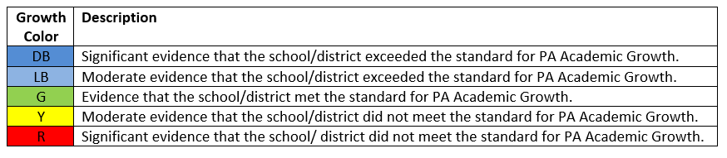
Indicators of Academic Growth PVAAS (40%)
The Pennsylvania Value Added Assessment System (PVAAS) growth index representing the school’s impact on the academic progress of groups of students from year-to-year.
 | Algebra | Literature | Biology
BASH | -1.9 Y | 10.0 DB | 2.2 LB

Slide 23
Indicators of Academic Growth Two Year Comparison
 | Algebra | Literature | Biology
BASH 2013-14 | NA* | 8.2 DB | 8.4 DB
BASH 2014-15 | -1.9 Y | 10.0 DB | 2.2 LB
* There were not enough students taking the Algebra I Keystone for the first time in 2013-14 to generate a BASH PVAAS score.

Slide 24
Other Academic Indicators (10%)
The final 10% of the School Performance Profile score is made up of the following pieces of information:
      Cohort graduation rate
      Attendance rate
      Advanced Placement (AP) or International Baccalaureate (IB) Diploma or college credit
      PSAT/PLAN Participation
 | Cohort Graduation Rate | Attendance Rate | Advanced Placement or College Credit | PSAT/PLAN Participation
BASH | 92.32%* | 96.69% | 100% | 100%
*This performance measure represents the percent of students in the school who graduate in four years with a regular high school diploma. The value represented for the reported year is the graduation rate calculated for one year previous to the reported year due to availability of this data.
Notes:
*This performance measure represents the percent of students in the school who graduate in four years with a regular high school diploma. The value represented for the reported year is the graduation rate calculated for one year previous to the reported year due to availability of this data.
**The performance measure for "Advanced Placement or College Credit" is determined based on the number of offerings (4 core areas is 100%, 3 core areas is 75% etc.).
***The performance measure for "PSAT/Plan Participation" is determined by converting the percent of grade 12 students who have a record of taking either the PSAT or Plan assessment prior to graduation to a scaled score (more than 60% participation results in a scaled score of 100).

Slide 25
Other Academic Indicators (10%)
Two Year Comparison
 | Cohort Graduation Rate | Attendance Rate | Advanced Placement or College Credit | PSAT/PLAN Participation
BASH 2013-14 | 93% | 95% | 100% | 100%
BASH 2014-15 | 92%* | 97% | 100% | 100%
*This performance measure represents the percent of students in the school who graduate in four years with a regular high school diploma. The value represented for the reported year is the graduation rate calculated for one year previous to the reported year due to availability of this data.
Notes:
*This performance measure represents the percent of students in the school who graduate in four years with a regular high school diploma. The value represented for the reported year is the graduation rate calculated for one year previous to the reported year due to availability of this data.
**The performance measure for "Advanced Placement or College Credit" is determined based on the number of offerings (4 core areas is 100%, 3 core areas is 75% etc.).
***The performance measure for "PSAT/Plan Participation" is determined by converting the percent of grade 12 students who have a record of taking either the PSAT or Plan assessment prior to graduation to a scaled score (more than 60% participation results in a scaled score of 100).

Slide 26
Extra Credit for Advanced Achievement
(up to 7 points)
Bonus points can be earned in each of the following areas:
  Percent Advanced on Pennsylvania State Assessments
    Keystone or PSSA
  Percent Advanced on industry standards-based competency assessments (NOCTI : a job ready assessment for career and technical center students)
  Advanced Placement achievement (scores 3 or higher)
 | Math | ELA | Science | Industry Standards | AP Exam Achievement
BASH | 17.34% | 9.64% | 30.72% | 66.07% | 59.60%

Slide 27
Extra Credit for Advanced Achievement
Two Year Comparison
 | Math | ELA | Science | Industry Standards | AP Exam Achievement
BASH 2013-14 | 12% | 12% | 22% | 73% | 56%
BASH 2014-15 | 17% | 10% | 31% | 66% | 60%

Slide 28
School Performance Profile Scores
School | SPP
Boyertown Area Senior High | 84.3
Notes:
3rd in Berks County
17th in Montgomery

Slide 29


Slide 30
2014-2015 Keystone Exams
First Time Test Takers
Percent Proficient or Advanced
 | Literature | Biology | Algebra
2014-15 | 80 | 77 | 74
Notes:
Here is how we performed as compared to the state.

Slide 31
Keystone Exams
Notes:
District Wide
In Algebra realize the curriculum/sequence change caused a huge change in numbers tested.
2012-13 1177
2013-14 461
2014-15 595

Slide 32
2014-2015 PSSA
Percent of Students Scoring Proficient or Advanced
 | Pennsylvania State Wide Results |  | Boyertown Area School District Results
Grade | English/Language Arts | Math | English/Language Arts | Math
3 | 62 | 49 | 74 | 60
4 | 59 | 44 | 70 | 63
5 | 62 | 43 | 74 | 62
6 | 61 | 40 | 80 | 66
7 | 59 | 33 | 74 | 56
8 | 58 | 30 | 70 | 43
Notes:
Here is how we performed as compared to the state.

Slide 33
Comparison of the Percent of Students
Scoring Proficient or Advanced
 | ELA 2014 |  |  |  |  | ELA 2015
Grade | State | BASD |  | Difference |  | State | BASD |  | Difference |  | Difference Between Years in ELA
3 | 70 | 86 |  | 16 |  | 62 | 74 |  | 12 |  | -4
4 | 69 | 83 |  | 14 |  | 59 | 70 |  | 11 |  | -3
5 | 61 | 78 |  | 17 |  | 62 | 74 |  | 12 |  | -5
6 | 65 | 84 |  | 19 |  | 61 | 80 |  | 19 |  | 0
7 | 72 | 87 |  | 15 |  | 59 | 74 |  | 15 |  | 0
8 | 80 | 88 |  | 8 |  | 58 | 70 |  | 12 |  | 4

Slide 34
Comparison of the Percent of Students
Scoring Proficient or Advanced
 | Math 2014 |  |  |  |  | Math 2015
Grade | State | BASD |  | Difference |  | State | BASD |  | Difference |  | Difference Between Years in Math
3 | 75 | 89 |  | 14 |  | 49 | 60 |  | 11 |  | -3
4 | 76 | 92 |  | 16 |  | 44 | 63 |  | 19 |  | 3
5 | 67 | 87 |  | 20 |  | 43 | 62 |  | 19 |  | -1
6 | 72 | 94 |  | 22 |  | 40 | 66 |  | 26 |  | 4
7 | 76 | 94 |  | 18 |  | 33 | 56 |  | 23 |  | 5
8 | 74 | 93 |  | 19 |  | 30 | 43 |  | 13 |  | -6

Slide 35

PVAAS
Growth
Data
Notes:
Discuss the difference between growth and achievement.
Achievement is getting over a certain threshold regardless of starting point.
Growth takes into consideration the starting point to determine if actual learning has occurred.
Better because it focuses on the idea that all students should be learning.

Slide 36
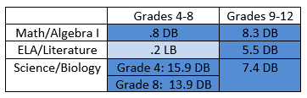
District Wide Growth Data
3-Year Measure by Standards Group

Slide 37
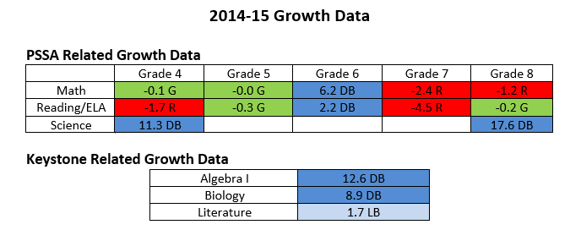

Slide 38
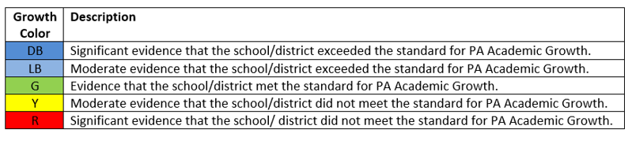
PSSA PVAAS Comparison 2013-14 to 2014-15
 | Grade 4 | Grade 5 | Grade 6 | Grade 7 | Grade 8
Math 13-14 | .8 LB | -1.7 R | 6.7 DB | -5.2 R | .5 LB
Math 14-15 | -.1 G | -0.0 G | 6.2 DB | -2.4 R | -1.2R
Reading 13-14* | .3 G | 1.7 DB | 3.9 DB | -2.9 R | -1.1 R
ELA 14-15* | -1.7 R | -.3 G | 2.2 DB | -4.5 R | -.2 G
Science 13-14 | 20.8 DB | NA | NA | NA | 16.7 DB
Science 14-15 | 11.3 DB | NA | NA | NA | 17.6 DB
* Starting in 2014-15 the ELA assessment replaced the reading and writing assessments.
Notes:
Reading and ELA is not a true comparison due to the addition of the writing component.

Slide 39
Keystone PVAAS Comparison 2013-14 to 2014-15
 | Secondary
Algebra I 13-14 | 10.3 DB
Algebra I 14-15 | 12.6 DB
Literature 13-14 | 7.4 DB
Literature 14-15 | 1.7 LB
Biology 13-14 | 7.4 DB
Biology 14-15 | 8.9 DB

Slide 40
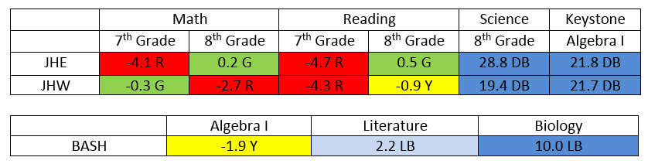
PVAAS Growth Data
Secondary
English Language Arts
Notes:
Insert 2 year comparison.

Slide 41
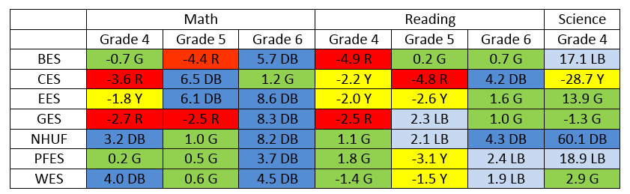
PVAAS Growth Data
Elementary
English Language Arts

Slide 42
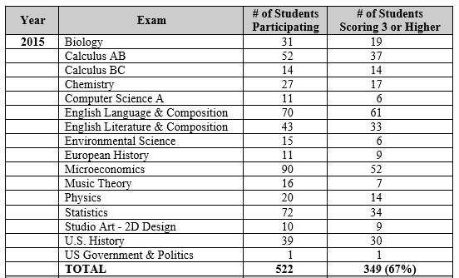
Advanced Placement

Slide 43
Advanced Placement
Number of Students Scoring a 3 or Higher
Notes:
Some kids don’t take the test…
We do not pay.

Slide 44
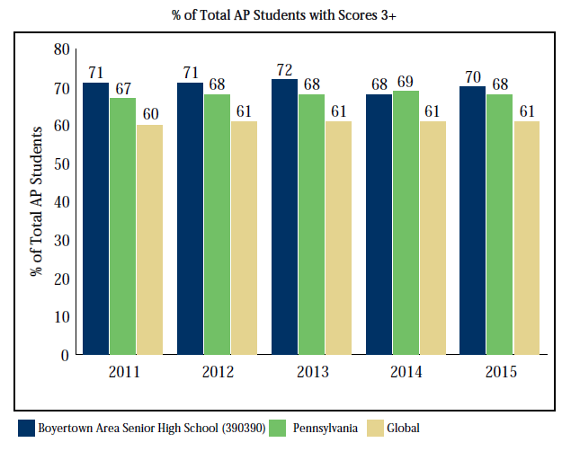

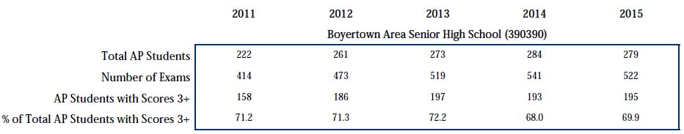
Notes:
279 unique students out of the high school.
Not necessarily seniors.
349 tests had a 3 or higher.

Slide 45
Concurrent/Dual Enrollment Participation
Notes:
13 courses

Slide 46
Extra-Curricular Activities
Number of Students Participating
2014-15 | Sports | Music & Theatre | Clubs & Activities
Junior High | 919 | 1010 | 2413
High School | 775 | 576 | 694
Total | 1694 | 1586 | 3107
Individual students may be involved in multiple activities.

Slide 47
Student Participation
Two Year Comparison

Slide 48
Extra-Curricular Activities
Number of Students Participating
2014-15 | Sports | Music & Theatre | Clubs & Activities
Junior High | 919 | 1010 | 2413
High School | 775 | 576 | 694
Total | 1694 | 1586 | 3107
2013-14 | Sports | Music & Theatre | Clubs & Activities
Junior High | 888 | 1107 | 2933
High School | 620 | 580 | 565
Total | 1508 | 1687 | 3498

Slide 49
What do we do with this information…
Data Retreat
  Building Action Plans
Teachers’ PLC Meetings
Decide on Professional Learning Needs
Principal Collaboration Meetings
With the ultimate goal of increasing student achievement.

